Slide 1
ELDERLY SOCIAL APP
Instructor: Duygu Celik
Assistants: Nada Kollah
Group NO: 10
Team Leader:
Team Members:
EDIDIONG OTOBONG ETUK 21902156
EMMANUEL MAGALA 21901595
DALLY AITA 1870114
NARLIN SILA 19000092

Slide 2
OUTLINE
INTRODUCTION
OVERVIEW OF SYSYTEM
PROTOTYPE
TESTING
CONCLUSION

Slide 3


ELDERLY SOCIAL APPLICATION
The application is a social platform for the elderly (above 60) to communicate and foster relationships.
Actors of system
Administrator
Elderly User

Slide 4
AIMS OF PROJECT
Fostering relationships among the old people
Combat loneliness among the elderly
Promote mental and emotional wellbeing
Create group in the elderly community

Slide 5
CONSTRAINTS
Technical Proficiency
Security and Privacy
Health considerations
Customer support

Slide 6
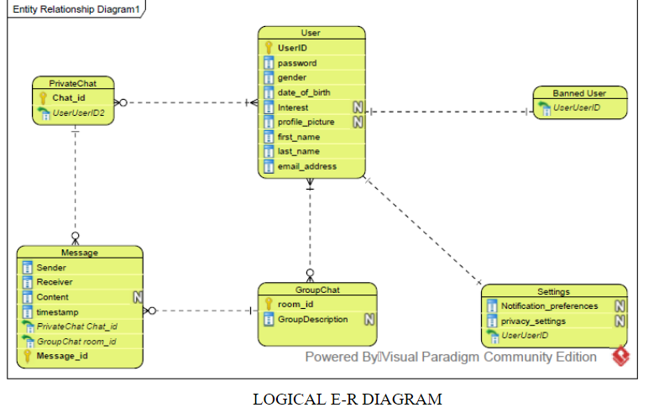
Entity Relationship diagram

Slide 7
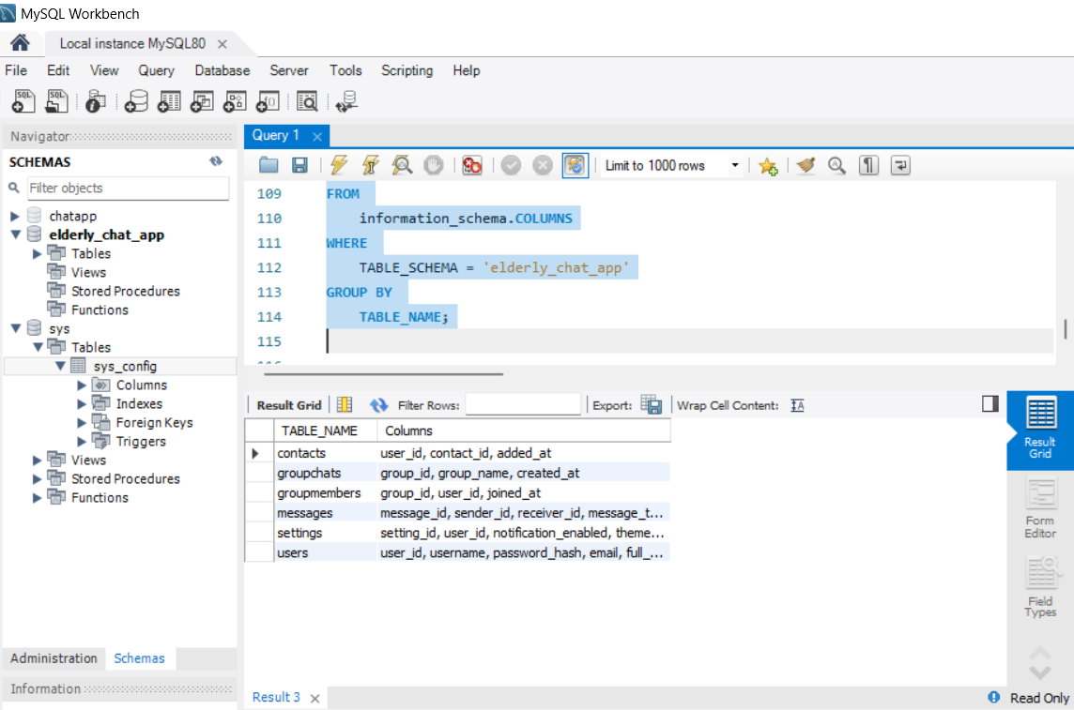
DATABASE OF THE SYSTEM

Slide 8
PROTOYPE OF SYSTEM

Slide 9
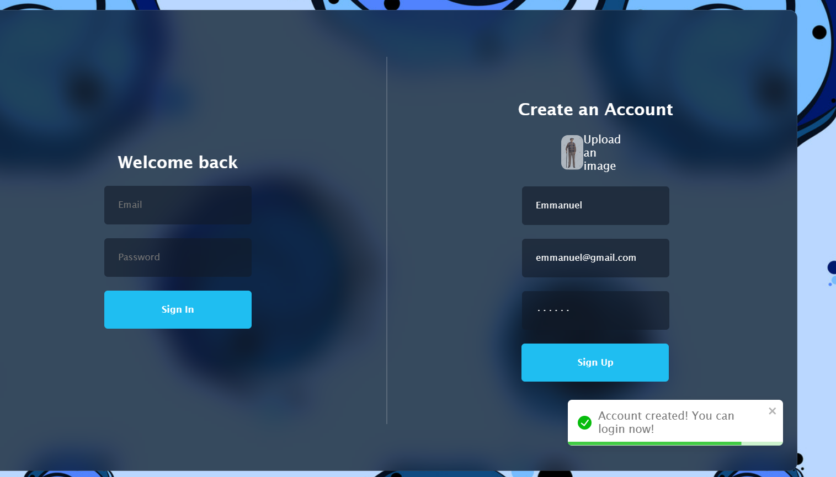
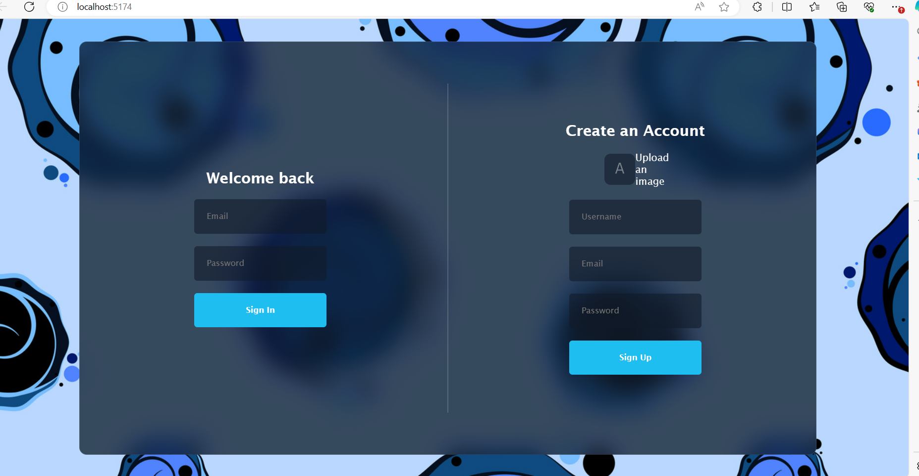
LOGIN PAGE

Slide 10
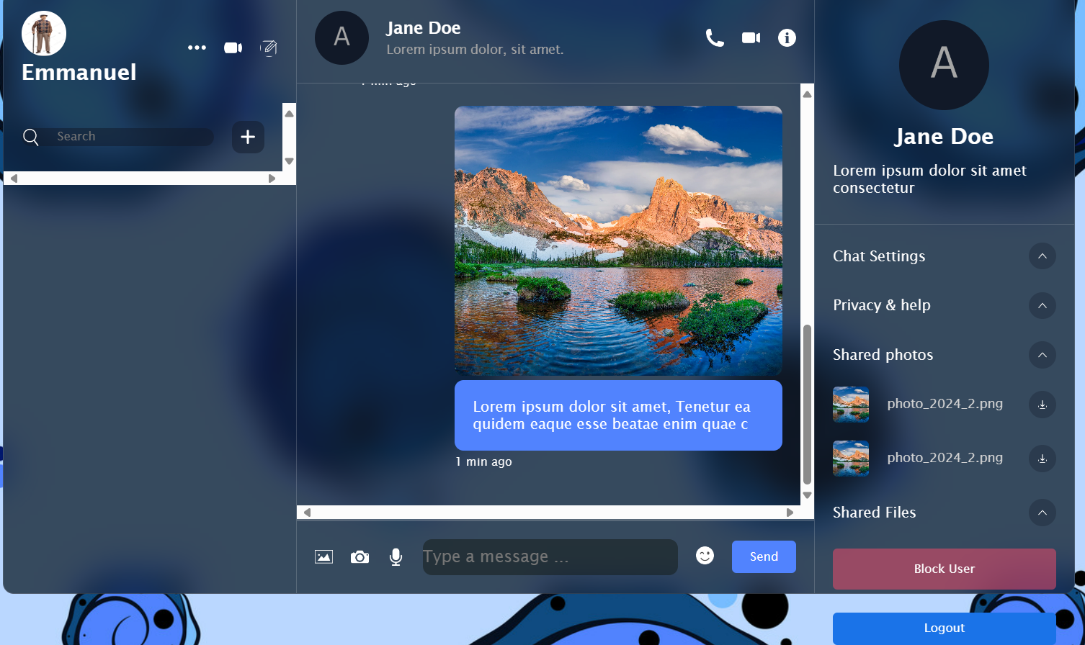
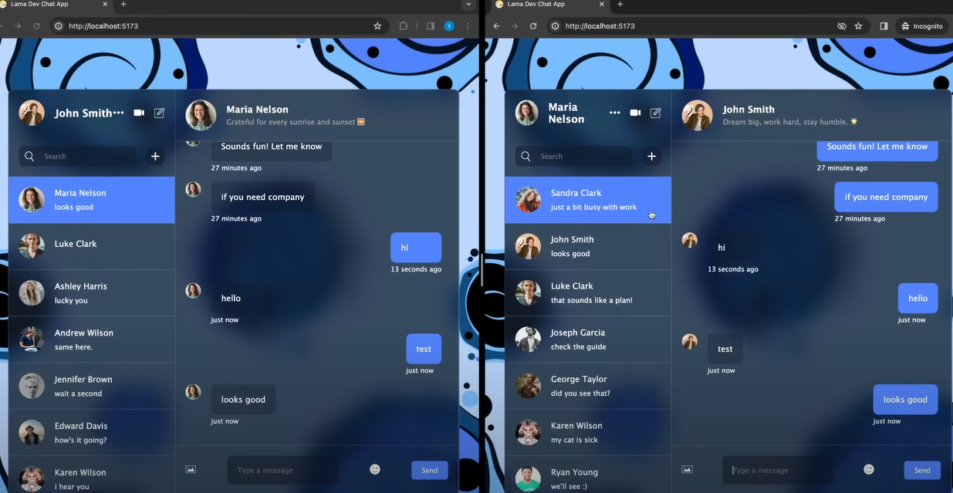
INSIDE THE APPLICATION

Slide 11
TESTING
Method of testing:
Functional testing: we verified all features and functions of website i.e. checking links, forms, buttons
Usability testing : We observed the interactions among with website
Compatibility We tested weather the website worked on various websites such as google safari
Unit testing: We tested weather individual components worked

Slide 12
conclusion
During this project, we partially implemented an elderly social application.
Improvements:
Changing the application from a website to a mobile app
Extension of scope to add a nursing service , dating service

